Slide 1

Eastern Carolina Rural Planning Organization
TCC and TAC Meeting
July 17th, 2025

Slide 2
TCC Agenda Items
1. Roll Call
2. Public Comment Period
3. ACTION: Approval of Regular Meeting Agenda
4. ACTION: Approval of Minutes
5. ACTION: Approve Draft SPOT Prioritization 8.0 Project List
Resource: ECRPO P8.O Proposed Project Map

Slide 3
TCC Agenda Items
6. ACTION: Approve Draft SPOT Prioritization 9.0 Express Design Project List
7. ACTION: Approve Letter of Support for Duplin County Transit
8. ECRPO Staff Report
9. NCDOT Report
10. Other Business

Slide 4
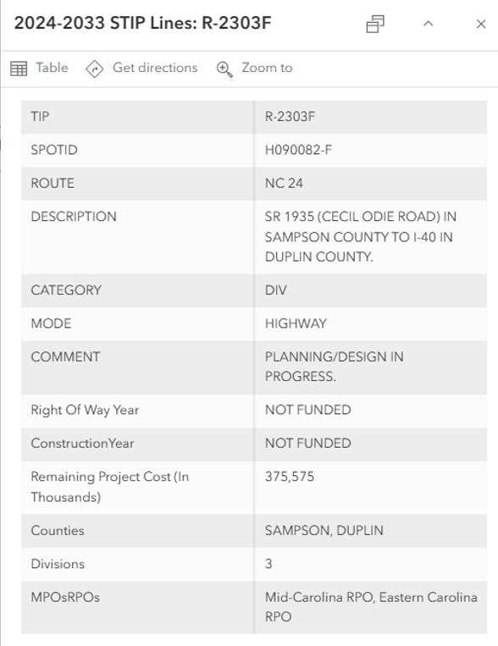
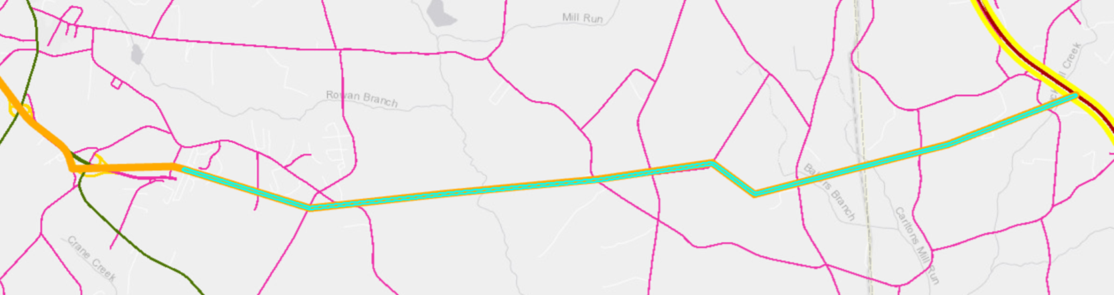
R-2303F splits on map shown in light green from Orange line (NC 24 - completed R-2303E) to Yellow/Red (US 40)
R-2303E was completed end of 2023 = Cecil Odie Road
Alt 1 – A & B sections proposed – top of map
Alt 2 – A & B sections proposed – bottom of map

Slide 5
TAC Agenda Items
1. Public Comment Period
2. Ethics Awareness and Conflict of Interest Reminder
3. ACTION: Approval of Regular Meeting Agenda
4. ACTION: Approval of Minutes
5. ACTION: Approve Draft SPOT Prioritization 8.0 Project List

Slide 6
TCC Agenda Items
6. ACTION: Approve Draft SPOT Prioritization 9.0 Express Design Project List
7. ACTION: Approve Letter of Support for Duplin County Transit
8. Other Business

Slide 7







































What is a Comprehensive Transportation Plan? (CTP)
Copy/paste any of the icons below into your presentation. Please change color to white if using them on a dark background.
Carlos Moya
NCDOT Transportation Planning Division
Eastern Carolina RPO
July 17, 2025
Notes:
Last plan was adopted in 2012
Introduce Dominique [TPD], Carlos [TPD], Luis [TPD], Len White [Div. 2], Mickey Anderson [ECRPO]

Slide 8

What is A CTP?
Other slide variations are available. Select Insert above and click on the drop menu beside “new slide” to see all the options.
What Is A CTP?
For informational purposes only
No decision from this board is needed
Comprehensive Transportation Plan
  It is long range needs-based plan (~25-30 years)
  Represents consensus on a future transportation system
  It is multimodal
      Highway
      Bicycle / Pedestrian
      Public Transportation / Rail
Notes:
Bullet 2: Area and NCDOT
Bullet 3: ferries also

Slide 9
What is A CTP?
Other slide variations are available. Select Insert above and click on the drop menu beside “new slide” to see all the options.
What Is A CTP?
Comprehensive Transportation Plan
  Developed cooperatively with:
    NCDOT
    Municipalities
      Town of Hookerton, Town of Snow Hill, and Town of Walstonburg
    Greene County
    Eastern Carolina Rural Planning Organization (ECRPO)
    Community Stakeholders
    The public

Slide 10
What is A CTP?
Other slide variations are available. Select Insert above and click on the drop menu beside “new slide” to see all the options.
What Is A CTP?
Comprehensive Transportation Plan
  It is adopted or endorsed at three levels:
    Locally
    Eastern Carolina Rural Planning Organization
    NCDOT Board of Transportation
  It is the first step of the development of a project
  It is a requirement of NC State Statute § 136-66.2
Notes:
Project Engineer to explain what “locally” means for this CTP

Slide 11
How a CTP fits into the Construction process
Other slide variations are available. Select Insert above and click on the drop menu beside “new slide” to see all the options.
What Is A CTP?
Long-Range Planning
Determining the Need
CTP
Prioritization & Funding
Project is scored and funded
Project Planning and Design
Minimize Impacts, Refine, and Design
Construction
Building the Project
Maintenance and Operations
Make infrastructure last longer and perform better

Slide 12
How a CTP fits into the Construction process
Other slide variations are available. Select Insert above and click on the drop menu beside “new slide” to see all the options.
What Is A CTP?
Long-Range Planning
Determining the Need
CTP
  CTP Project Proposals
  Are high level plans – are not final designs
  Will go through more detailed environmental review and design after the CTP, before final decisions are made
Prioritization & Funding
Project is scored and funded
Project Planning and Design
Minimize Impacts, Refine, and Design
Construction
Building the Project
Maintenance and Operations
Make infrastructure last longer and perform better

Slide 13
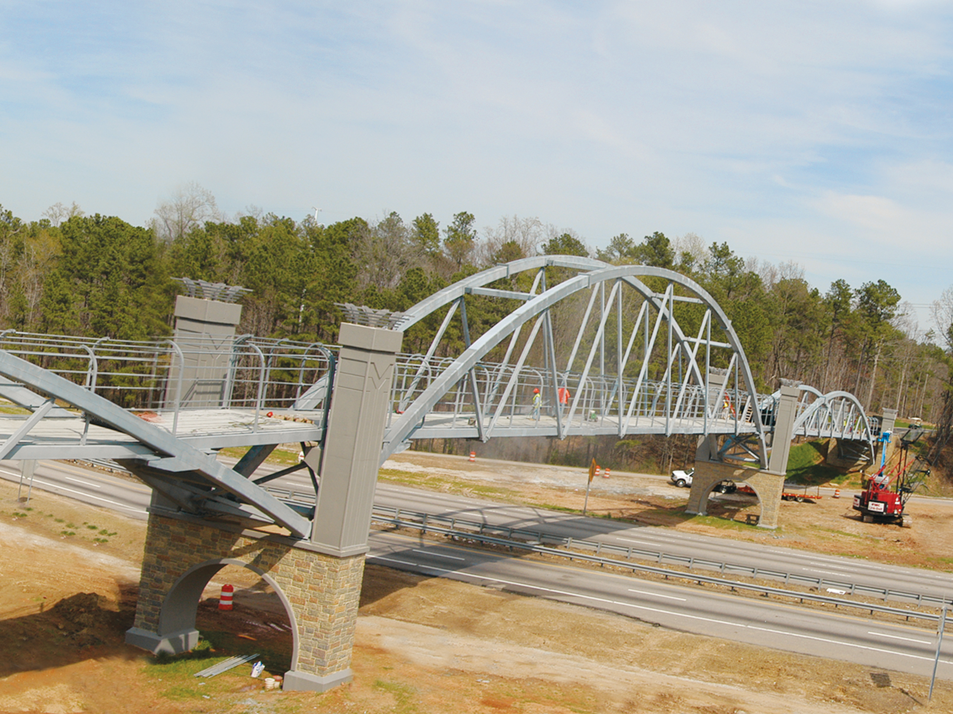
CTPs are ‘Needs-Based’ Plans
Other slide variations are available. Select Insert above and click on the drop menu beside “new slide” to see all the options.
What Is A CTP?
  CTP Recommendations:
    Address an identified transportation need
    Are based on analysis
    Provide a feasible solution
  CTPs are not intended to identify ‘wants’, ‘wish-list, or projects needed beyond the 25-30 years time-frame

Slide 14
CTPs creates project proposals and uses data from other plans
Other slide variations are available. Select Insert above and click on the drop menu beside “new slide” to see all the options.
What Is A CTP?
A sampling of the data considered in a Comprehensive Transportation Plan
And More
State Transportation Improvement Program (Funded)
Local Land Development or Land Use Plans
Local & Statewide Transportation Plans
Local & Statewide Bike / Ped / Transit Plans
Information from these plans and other data go through the CTP analysis Process
Notes:
Use some STIP projects, and then analyze other plans

Slide 15
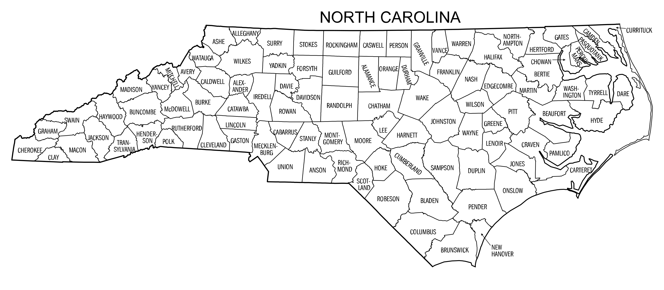

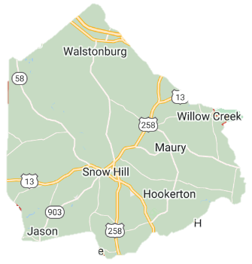
CTP Process
Other slide variations are available. Select Insert above and click on the drop menu beside “new slide” to see all the options.
What Is A CTP?
  Typically takes 12-18 months
  Typical process
      Develop Local Vision
      System Assessment
      Analyze Alternatives
      Develop Draft Plan
      Adopt Plan
  Generally developed on a County, Rural Planning Organization (RPO), or Regional level

Slide 16

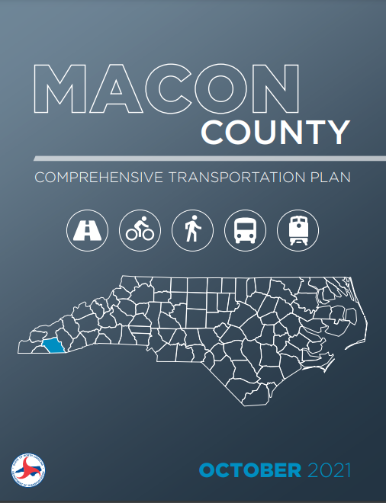
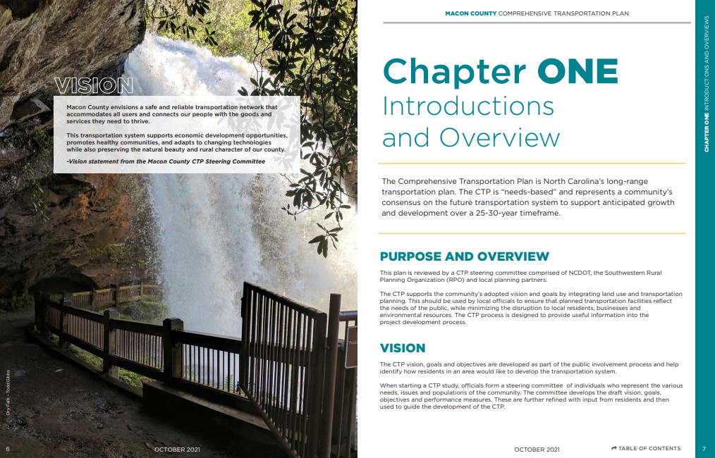
CTP Products
Other slide variations are available. Select Insert above and click on the drop menu beside “new slide” to see all the options.
What Is A CTP?
Deliverables an area will receive from the CTP Process
Scan link for CTP Example
User friendly Plan documentation
Covers study highlights

Slide 17
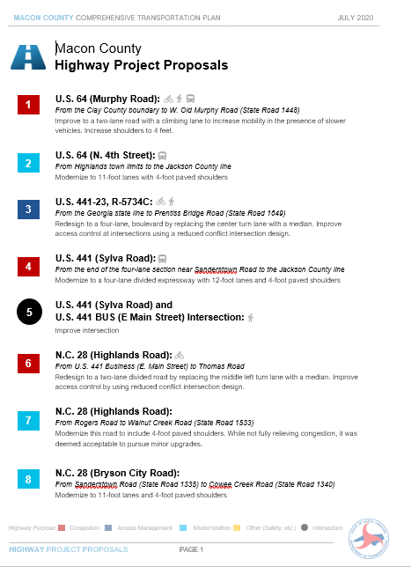
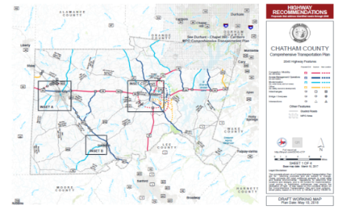
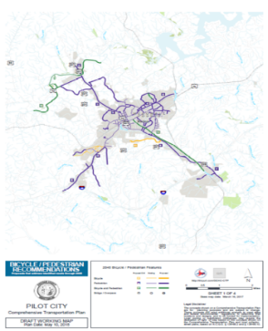
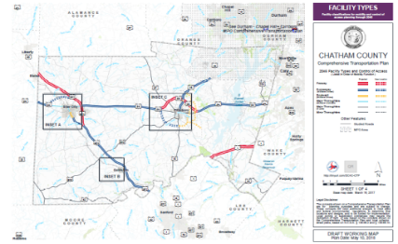
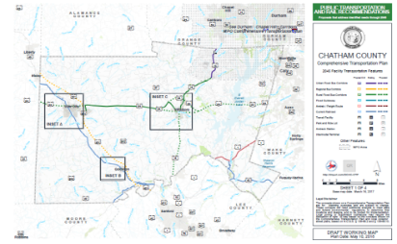
CTP Products
Other slide variations are available. Select Insert above and click on the drop menu beside “new slide” to see all the options.
What Is A CTP?
Deliverables an area will receive from the CTP Process
Recommendations Lists
Recommendations Maps

Slide 18
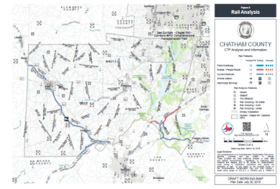
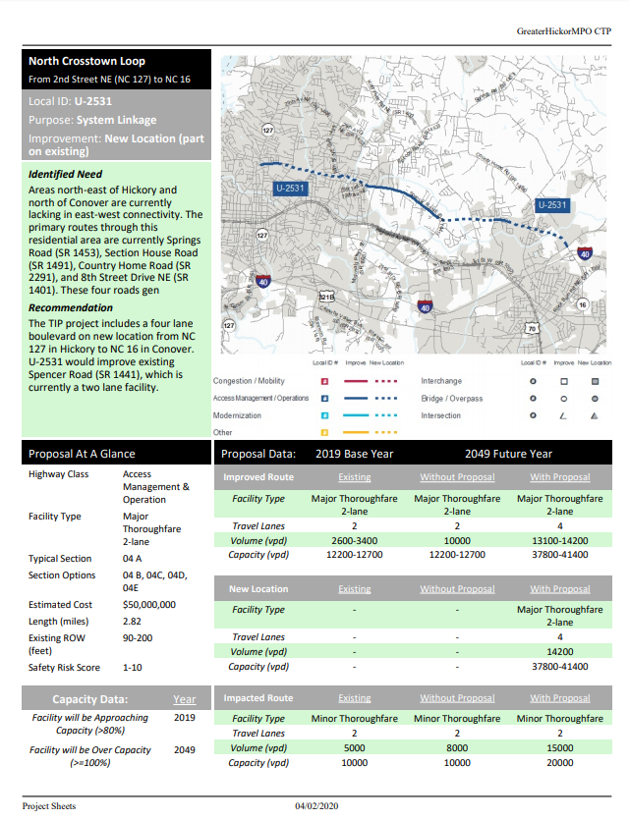
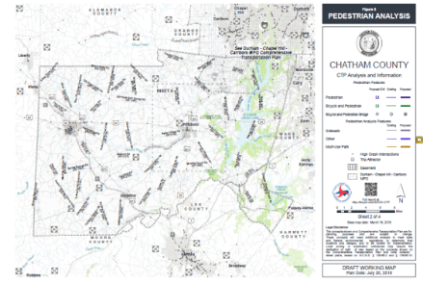

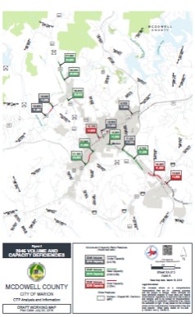
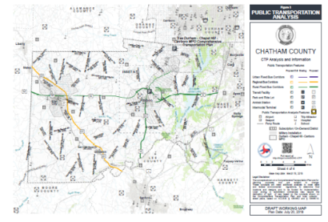
CTP Products
Other slide variations are available. Select Insert above and click on the drop menu beside “new slide” to see all the options.
What Is A CTP?
Deliverables an area will receive from the CTP Process
Analysis and Informational Maps
Project Sheets

Slide 19
Other slide variations are available. Select Insert above and choose “new slide” to see all the options.
Carlos Moya
Dominique Boyd
Luis Carmona
Len White
Mickey Anderson
NCDOT
NCDOT
NCDOT
Div. 2 Planning Engineer
RPO Coordinator
cemoya@ncdot.gov
dlboyd1@ncdot.gov
ljcarmona@ncdot.gov
lenwhite@ncdot.gov
manderson@eccog.org
919-707-0934
919-707-0932
919-707-2947
252-775-6108
252-571-7183
Jordan Kearney
RPO Coordinator
jkearney@eccog.org
252-229-4332

Slide 20
Other slide variations are available. Select Insert above and choose “new slide” to see all the options.

